Slide 1
Neural Joint Model for Transition-based Chinese Syntactic Analysis
Authors: Shuhei Kurita, Daisuke Kawahara, Sadao Kurohashi
Advisor: Jia-Ling Koh
Speaker: Yin-Hsiang Liao
Source: ACL 2017
Date: 2018/06/26

Slide 2
Outline
Introduction
Model
Experiments
Conclusion

Slide 3
Introduction
Goal:
Present a neural network-based joint model for Chinese word segmentation, POS tagging and dependency parsing.

Slide 4
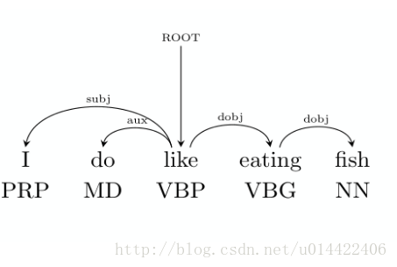
Introduction
Syntactic Analysis:
Parsing: Part-of-speech, dependency
Segmentation ( the nature of Chinese)
Error propagation:
Wrong segmentations lead mistake in parsing in the pipeline models.

Slide 5
Introduction
Joint model:
A joint learning framework combining missions
(SegTag, SegTagDep)
A traditional solution to error propagation problems.
(The improvement may be due to the extra useful information from the structure)

Slide 6
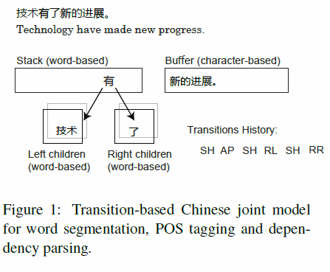
Introduction
Transition-based model:
Data Structures: A queue and a stack
Statue and Action

Slide 7
Outline
Introduction
Model
Experiments
Conclusion

Slide 8
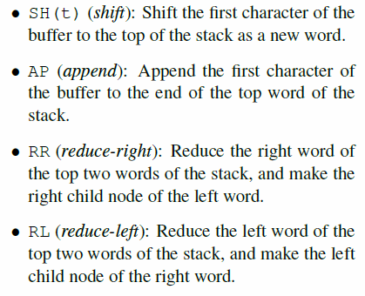
Model
POS tags

Slide 9
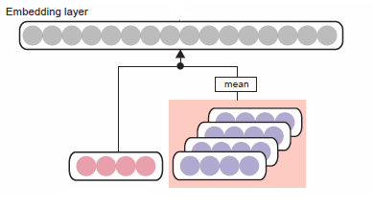
Model
Preprocessing:
Word / Character embeddings (Pretrained)
Embeddings of Character Strings
Inspiration: incomplete tokens may provide information.
Ex: 台北車站 vs. 北車 → no such a word in general lexicons
Word/characters
embeddings
Embeddings of characters
yes
no
is it in the embeddings?*
Character Strings

Slide 10
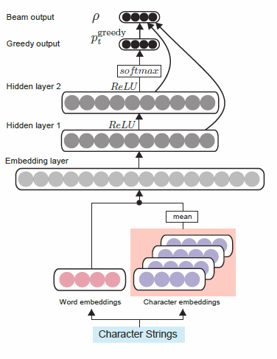
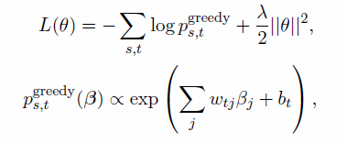
Model
(4+33)d*
Feed-forward Neural Network
Larger than previous works
Loss function (greedy):
Optimizer: Adagrad (quick convergence)
8000d
8000d
8200d*
https://vimeo.com/234944928

Slide 11
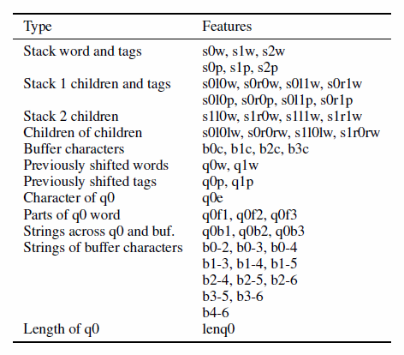
Model
Feature list:
S0w: the top word of stack
S1w: the second top word of stack
L0: the leftmost child
L1: the second leftmost child
R0: the rightmost child
R1: the second rightmost child
q0 = the last shifted word
q1 = the second shifted word
q0e = the end char of q0
q0f1 = the sub-word of q0 (q0[1:])
q0f2 = the sub-word of q0 (q0[2:])
q0b1 = strings across q0 and buff (q0+b[:1])
q0b2 = strings across q0 and buff (q0+b[:2])

Slide 12
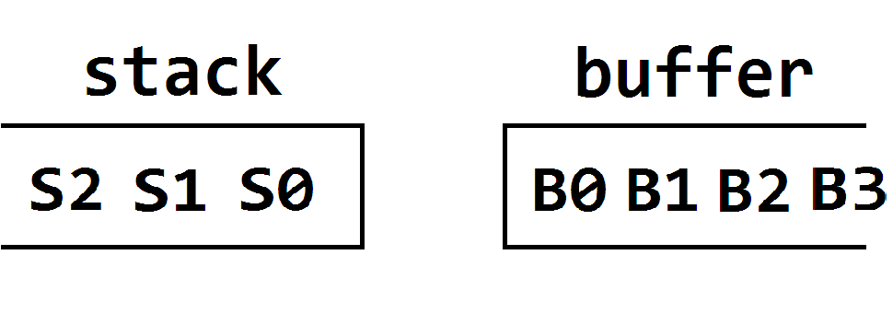
Model
Word-based
Char-based
L0
L1
R1
R0
L
R
B0-2
B0-3
L0
L1
R1
R0
L
R

Slide 13
Model
Word-based
Char-based
q0
q0b1
q0b2
0
1
2
…
e
q0b3
q0f1
q0f2

Slide 14
Text Embedding (200d)
POS Embedding (20d)
Length of q0 Embedding (20d)
40 text
9 pos
1
Word/characters
embeddings
Embeddings of characters
Word/characters
embeddings
Word/characters
embeddings
Embeddings of characters
Embeddings of characters
yes
no
yes
no
yes
no
is it in the embeddings?*
is it in the embeddings?*
is it in the embeddings?*
Character Strings
Character Strings
Character Strings

Slide 15
Model
Beam Search
A perceptron layer.
Inputs from hidden layers and the greedy output layer

Slide 16
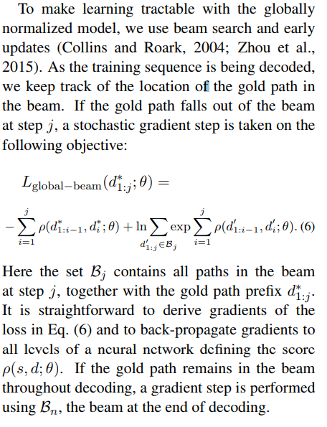
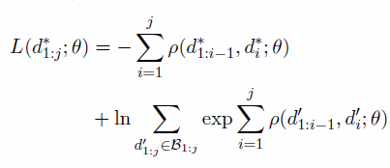
Model
Structured learning model proposed by Weiss et al. and Andor et al.

Slide 17
Model
My guess
yes
no
Backprop to embeddings
Only backprop to hidden layers
is golden path in the beam?

Slide 18
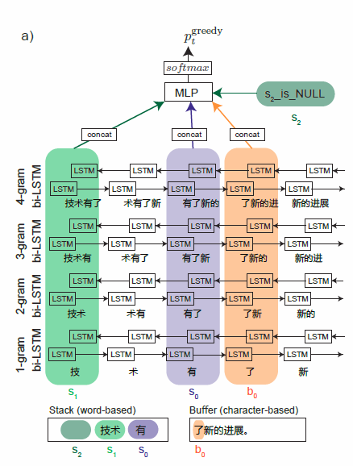
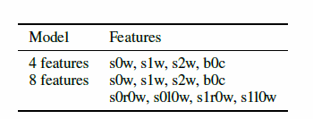
Model
Bi-LSTM
Can see whole sentence.
Light feature engineering.

Slide 19
Model
技
術
有
了
新
Is in embeddings?

Slide 20
Outline
Introduction
Model
Experiments
Conclusion

Slide 21
Experiments
Settings:
Penn Chinese Treebank 5.1 (CTB-5) and 7 (CTB-7).
Three FFNN models:
SegTag
SegTagDep
Dep (similar to Weiss et al. and Andor et al.)
Two Bi-LSTM models:
Bi-LSTM 4 feat
Bi-LSTM 8 feat

Slide 22
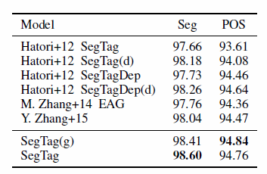
Experiments
Seg POS
SegTag does not use the children and children-of-children of stack word as feature.

Slide 23
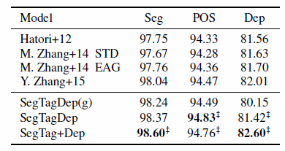
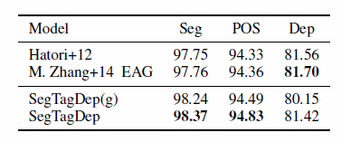
Experiments
Seg POS Dep

Slide 24
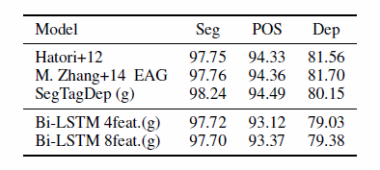
Experiments
Bi-LSTMs
Not better than FFNN

Slide 25
Outline
Introduction
Model
Experiments
Conclusion

Slide 26
Conclusion
Two joint parsing models are proposed by the feed-forward and bi-LSTM neural networks.
The character string embeddings help to capture the similarities of incomplete tokens.
SegTagDep model get better scores than previous joint models in Seg and POS.
SegTag + Dep achieves state-of-the-art dependency parsing score.

Slide 27
Reference
Daniel Andor et al. 2016. Globally normalized transition-based neural networks.
Jun Hatori et al. 2012. Incremental joint approach to word segmentation, pos tagging, and dependency parsing in Chinese.
David Weiss et al. 2015. Structured training for neural network transition-based parsing.

